Slide 1


Supervised Learning: regression and classification problems, Simple Linear Regression
Session No.: 08
Course Name: Machine Learning
Course Code: R1UC525B
Instructor Name: Dr. Sivakumar Madeshwaran
Duration: 50 Minutes
Date of Conduction of Class: 08-09-2026

Slide 2

Recap of Previous Lecture
Classification is a supervised learning task where models predict categorical outputs based on input features.
Types include Binary, Multi-class, and Multi-label Classification.
Training–testing split is essential for evaluating model performance and avoiding bias.
Overfitting & Underfitting are major challenges — models must balance complexity and generalization.
Different algorithms (Logistic Regression, kNN, Decision Trees, Random Forest, SVM, Naïve Bayes, Neural Networks) are used depending on the problem.
Conclusion: A well-designed classification model helps in accurate decision-making, but proper evaluation and control of overfitting/underfitting are key to reliable performance.

Slide 3
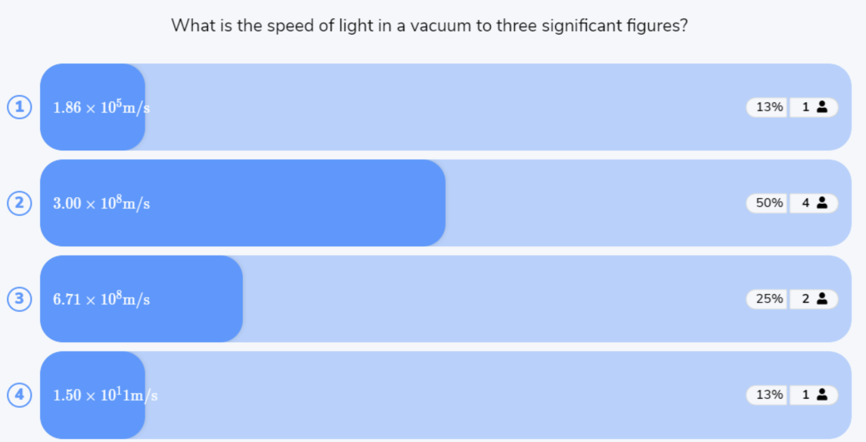
Reflect on the responses of post session activity

Slide 4



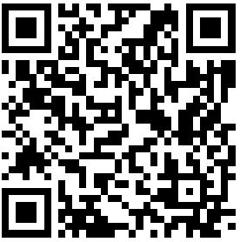
“If we know the number of hours a student studies, can we predict their exam marks?”
Opening Question

Slide 5
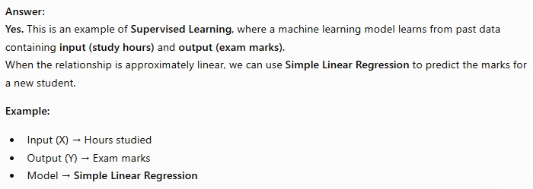
Opening Question -Reflections

Slide 6
At the end of this session students will be able to
LO1: Differentiate between regression and classification problems in supervised learning and identify suitable real-world applications for each.
LO2: Apply Simple Linear Regression to model the relationship between an input variable and a continuous output, and interpret the regression line and predictions.

Slide 7
Session Outline
1 Supervised Learning Basics
3 Activity-1 (Think –Pair -Share)
4 Activity-2 (Quiz on Wooflash)
5 Review and Reflections
2 Problem Types in Supervised Learning
Regression & Classification

Slide 8
Supervised Learning Basics
Supervised Learning is learning from examples where the correct answer is already known.
The data contains: Input (X) → Known Output (Y)
For example:
Study Hours | Marks
2 | 40
4 | 55
6 | 70
8 | 85
The model learns the relationship between study hours and marks.
Then, if we give: Study Hours = 7
the model can predict the expected marks.

Slide 9
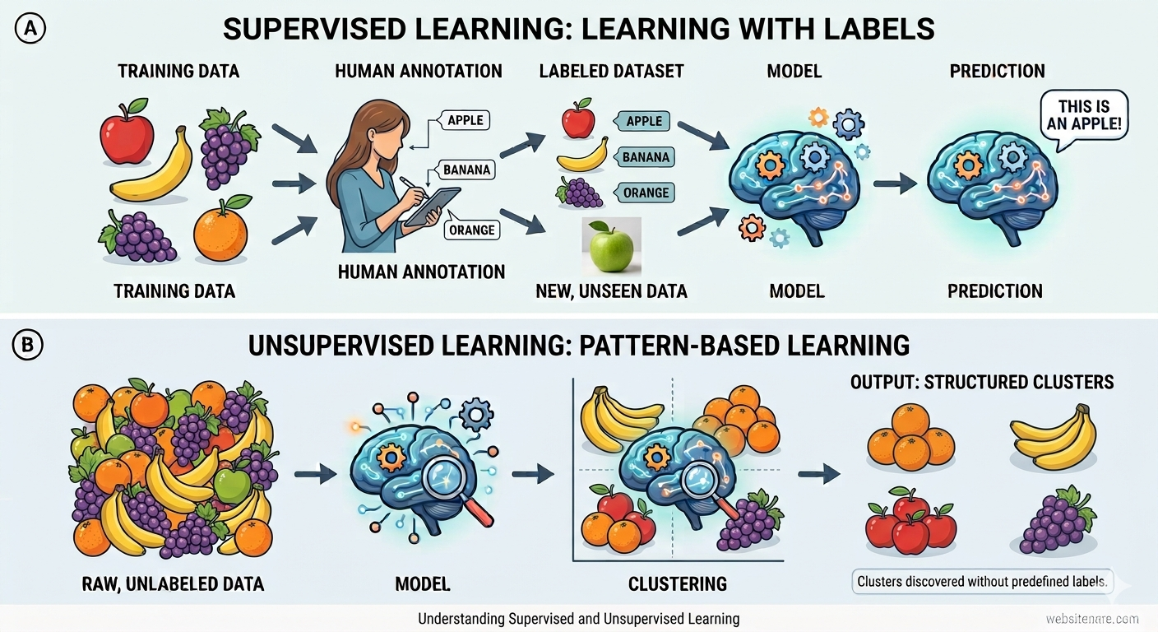
Supervised Learning Basics

Slide 10
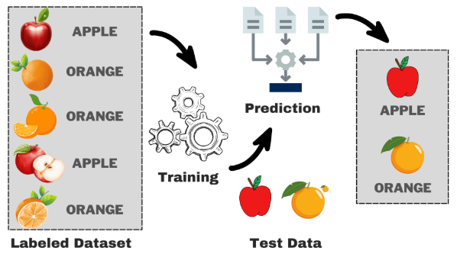
Supervised Learning Basics

Slide 11
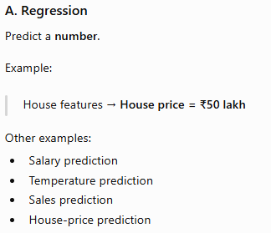
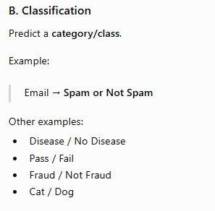
Supervised learning problems
Supervised Learning is mainly divided into:
Regression
B. Classification

Slide 12
Learning Activity-1: MCQ
1. What is the main purpose of supervised learning?
A. To find hidden patterns without labels
B. To learn from labeled data and predict outputs
C. To group similar data points
D. To randomly generate new data
2.Which of the following is an example of a classification problem?
A. Predicting house price
B. Predicting temperature
C. Predicting whether an email is spam or not spam
D. Predicting a student's exact marks
3.Which of the following is a common problem in supervised learning?
A. Overfitting
B. Data leakage
C. Insufficient training data
D. All of the above

Slide 13
Learning Activity-1: Think-pair-share
Reflections
1. What is the main purpose of supervised learning?
A. To find hidden patterns without labels
B. To learn from labeled data and predict outputs
C. To group similar data points
D. To randomly generate new data
Answer: B. To learn from labeled data and predict outputs
2.Which of the following is an example of a classification problem?
A. Predicting house price
B. Predicting temperature
C. Predicting whether an email is spam or not spam
D. Predicting a student's exact marks
Answer: C. Predicting whether an email is spam or not spam
3.Which of the following is a common problem in supervised learning?
A. Overfitting
B. Data leakage
C. Insufficient training data
D. All of the above
Answer: D. All of the above

Slide 14
Simple Linear Regression
Simple Linear Regression is one of the simplest regression algorithms.
It uses one input variable (X) to predict one output variable (Y).
Example
Suppose we want to predict house price based on house area.
X = House area
Y = House price
We collect data such as:
House Area (sq.ft) | Price (₹ lakh)
800 | 30
1000 | 38
1200 | 45
1500 | 55
1800 | 68

Slide 15
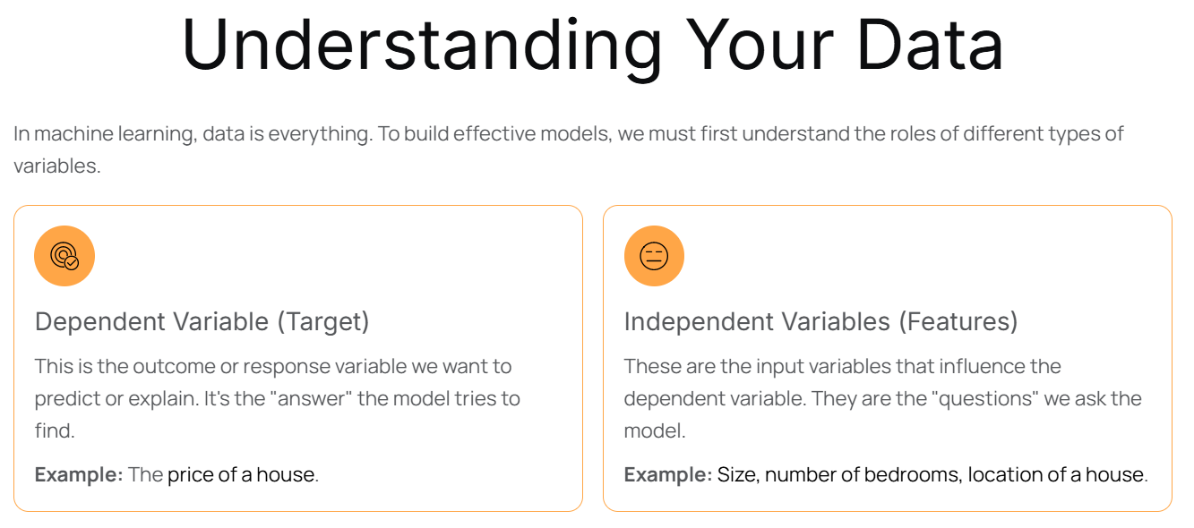
Simple Linear Regression

Slide 16
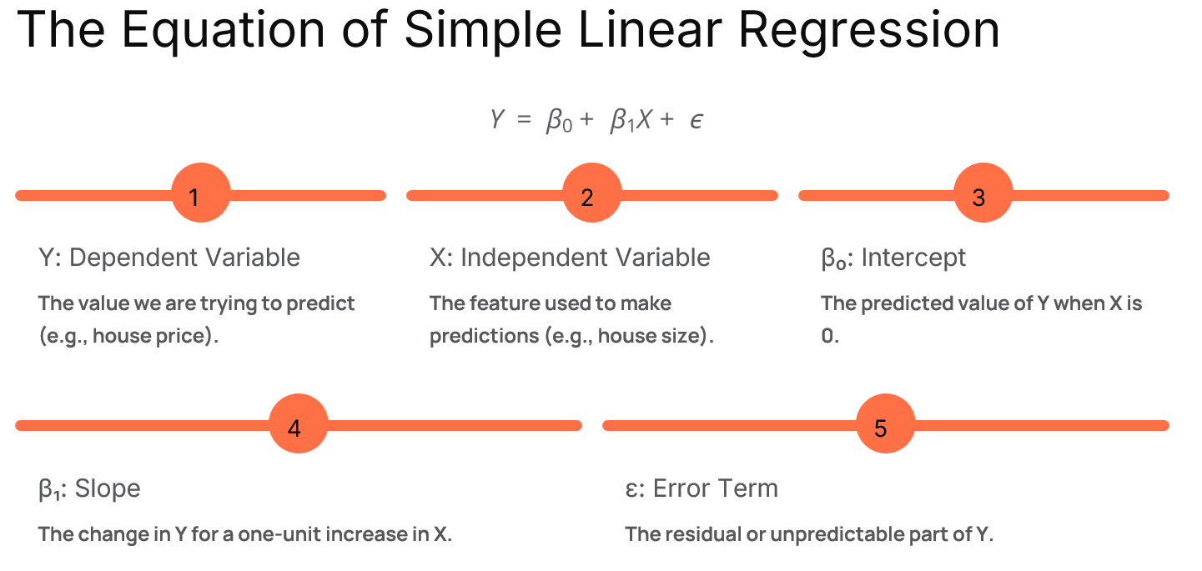
Simple Linear Regression

Slide 17
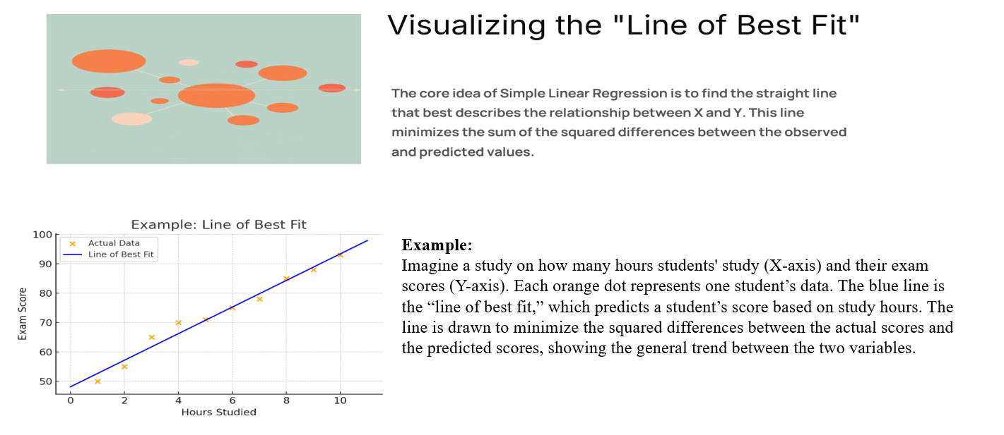
Simple Linear Regression

Slide 18
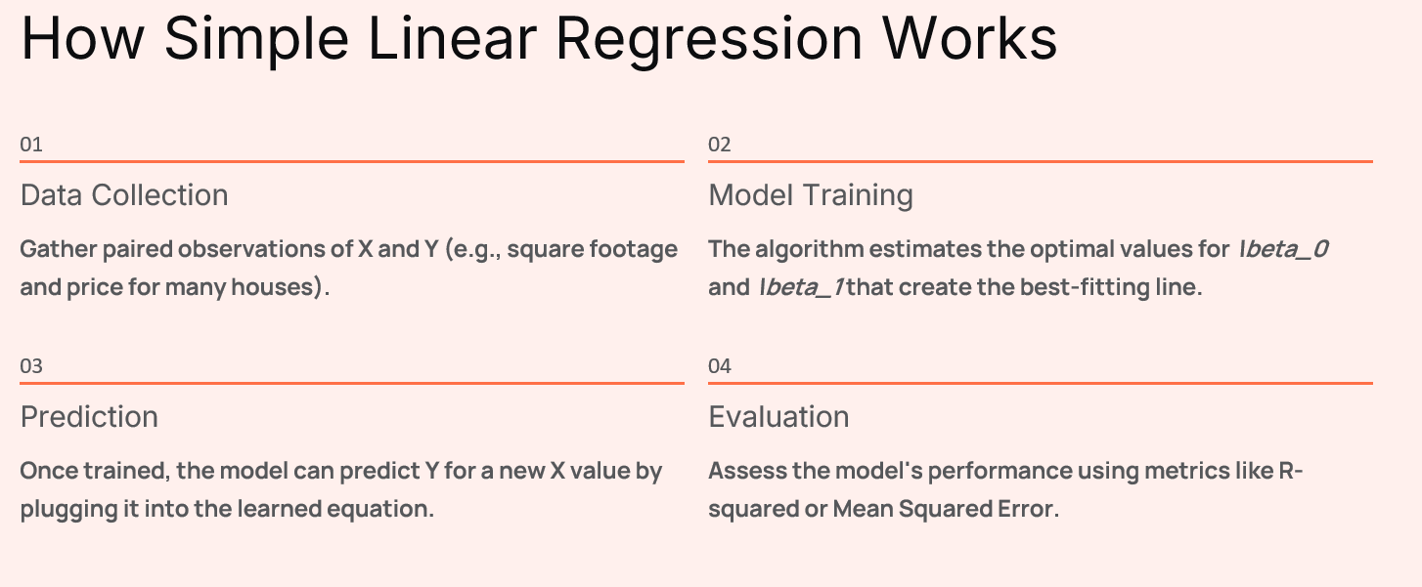
Simple Linear Regression

Slide 19
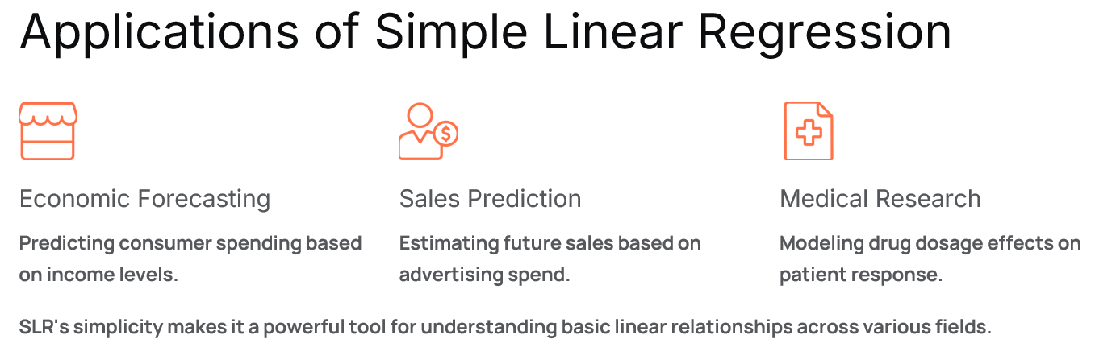
Simple Linear Regression

Slide 20
Learning Activity-2: Think-pair-share
Scenario:
A college wants to use Machine Learning to predict whether a student will Pass or Fail based on attendance, assignment marks, and study hours.

Slide 21
Learning Activity-2: Think-pair-share
Reflection of
Learning Activity-2

Slide 22
Summary
1 Supervised Learning Basics
3 Activity-1 (Think –Pair -Share)
4 Activity-2 (Quiz on Wooflash)
5 Review and Reflections
2 Problem Types in Supervised Learning
Regression & Classification

Slide 23
Ensure attainment of LOs in alignment to the learning activities: outcomes (1-2)
LO1: Differentiate between regression and classification problems in supervised learning and identify suitable real-world applications for each.
LO2: Apply Simple Linear Regression to model the relationship between an input variable and a continuous output, and interpret the regression line and predictions.

Slide 24
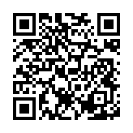
Post Session Activity

Slide 25
Information about the next lesson
Multiple Linear Regression

Slide 26

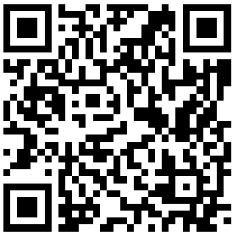
Review and Reflection from students

